Slide 1
Generation and Demodulation of Amplitude Modulated Signals
Gaurav S. Kasbekar
Dept. of Electrical Engineering
IIT Bombay

Slide 2
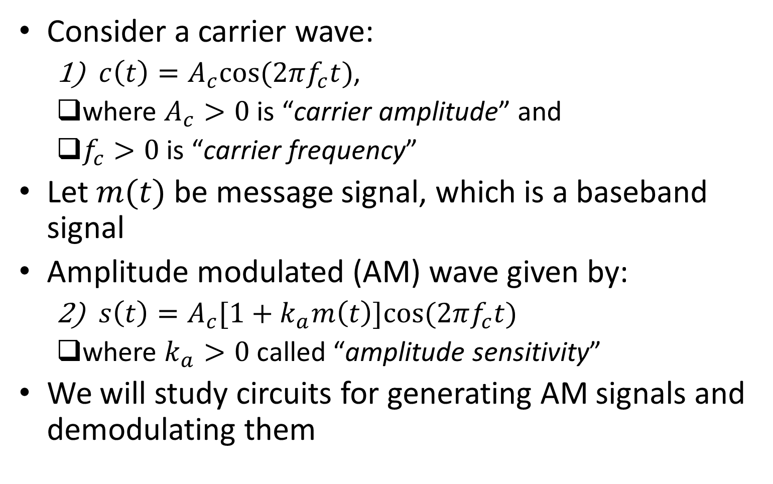
Introduction
Consider a carrier wave:
$c\left(t\right)=A_{c}cos⁡(2πf_{c}t)$,
where $A_{c}>0$ is “carrier amplitude” and
$f_{c}>0$ is “carrier frequency”
Let $m(t)$ be message signal, which is a baseband signal
Amplitude modulated (AM) wave given by:
$s\left(t\right)=A_{c}[1+k_{a}m\left(t\right)]cos⁡(2πf_{c}t)$
where $k_{a}>0$ called “amplitude sensitivity”
We will study circuits for generating AM signals and demodulating them

Slide 3
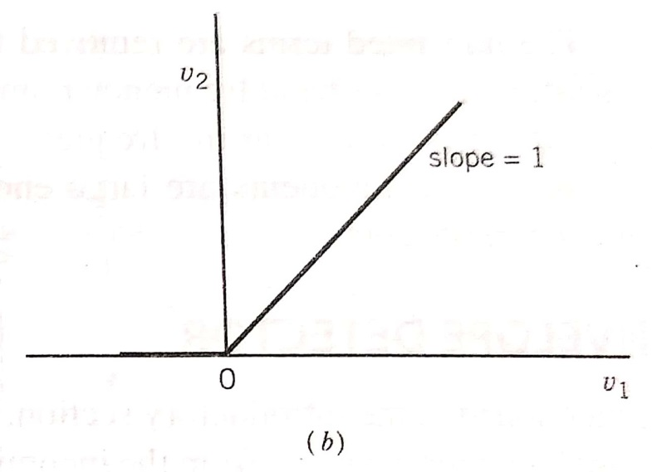
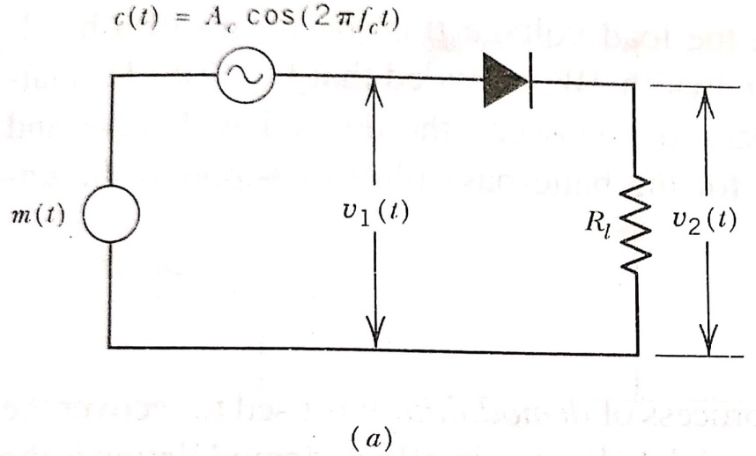
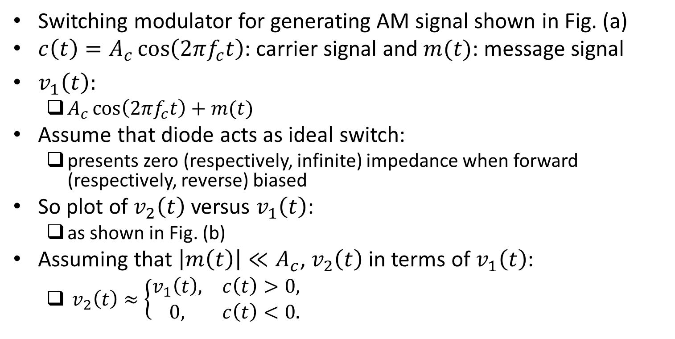
Switching Modulator
Switching modulator for generating AM signal shown in Fig. (a)
${c\left(t\right)=A}_{c}\cos\left(2πf_{c}t\right)$: carrier signal and $m(t)$: message signal
$v_{1}\left(t\right):$
$A_{c}\cos\left(2πf_{c}t\right)+m(t)$
Assume that diode acts as ideal switch:
presents zero (respectively, infinite) impedance when forward (respectively, reverse) biased
So plot of $v_{2}\left(t\right)$ versus $v_{1}\left(t\right)$:
as shown in Fig. (b)
Assuming that $\left|m\left(t\right)\right|≪A_{c}$, $v_{2}\left(t\right)$ in terms of $v_{1}\left(t\right)$:
$v_{2}\left(t\right)≈\left\{\begin{matrix}v_{1}\left(t\right), & c\left(t\right)>0, \\ 0, & c\left(t\right)<0.\end{matrix}\right.$
Ref: “Communication Systems” by S. Haykin and M. Moher, 5th ed

Slide 4
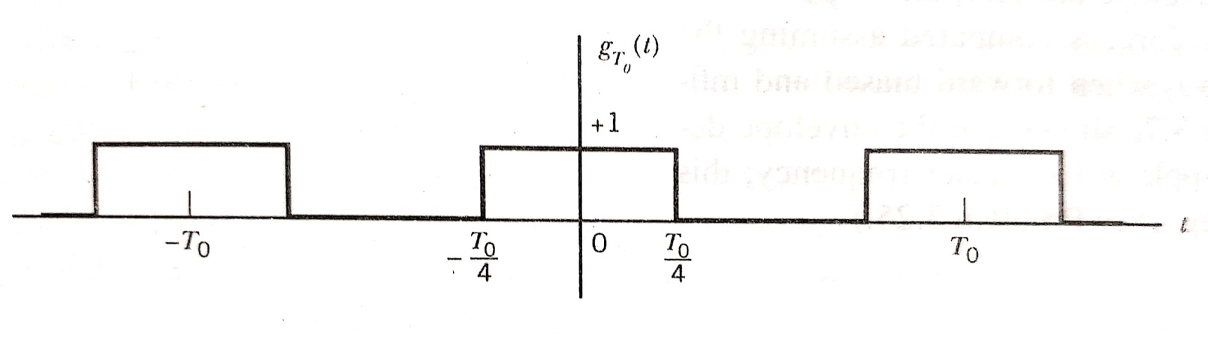
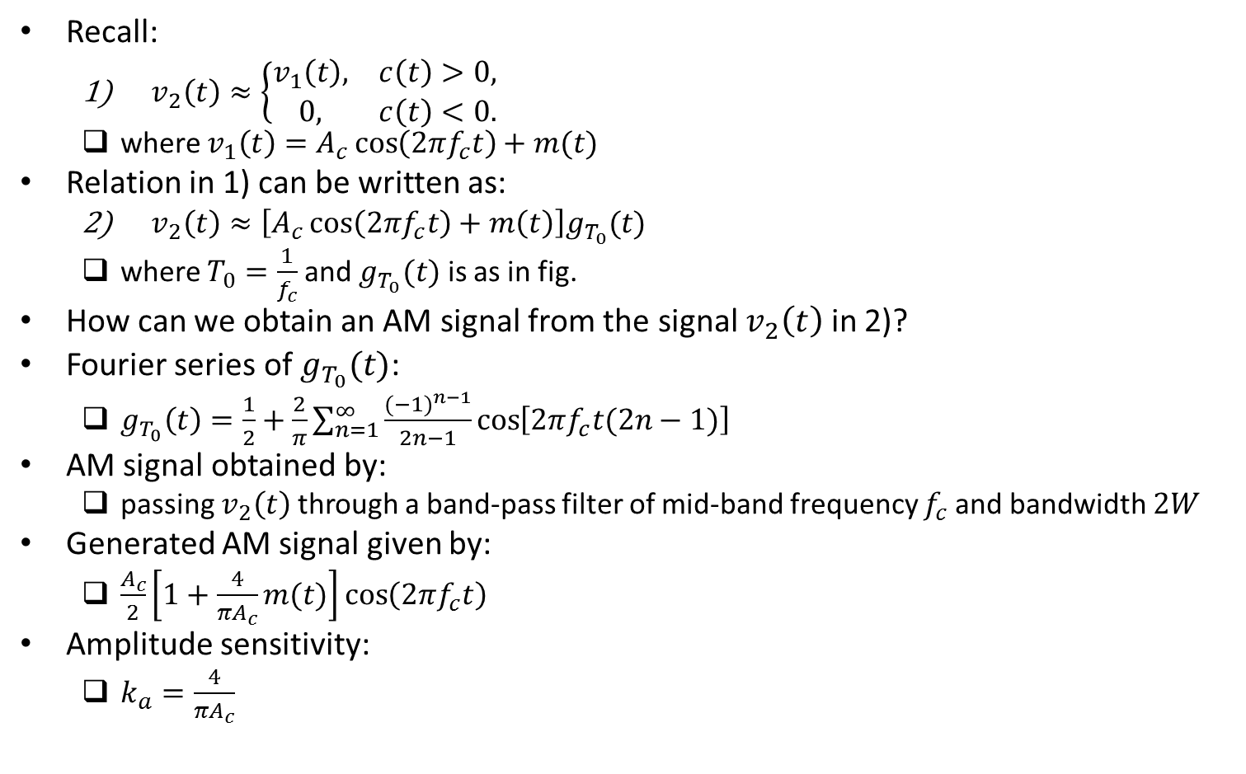
Switching Modulator (contd.)
Recall:
$v_{2}\left(t\right)≈\left\{\begin{matrix}v_{1}\left(t\right), & c\left(t\right)>0, \\ 0, & c\left(t\right)<0.\end{matrix}\right.$
where $v_{1}\left(t\right)=A_{c}\cos\left(2πf_{c}t\right)+m(t)$
Relation in 1) can be written as:
$v_{2}\left(t\right)≈\left[A_{c}\cos\left(2πf_{c}t\right)+m\left(t\right)\right]g_{T_{0}}(t)$
where $T_{0}=\frac{1}{f_{c}}$ and $g_{T_{0}}(t)$ is as in fig.
How can we obtain an AM signal from the signal $v_{2}\left(t\right)$ in 2)?
Fourier series of $g_{T_{0}}(t)$:
$g_{T_{0}}\left(t\right)=\frac{1}{2}+\frac{2}{π}\sum_{n=1}^{∞}{\frac{{(−1)}^{n−1}}{2n−1}}\cos\left[2πf_{c}t(2n−1)\right]$
AM signal obtained by:
passing $v_{2}\left(t\right)$ through a band-pass filter of mid-band frequency $f_{c}$ and bandwidth $2W$
Generated AM signal given by:
$\frac{A_{c}}{2}\left[1+\frac{4}{πA_{c}}m(t)\right]\cos\left(2πf_{c}t\right)$
Amplitude sensitivity:
$k_{a}=\frac{4}{πA_{c}}$
Ref: “Communication Systems” by S. Haykin and M. Moher, 5th ed

Slide 5
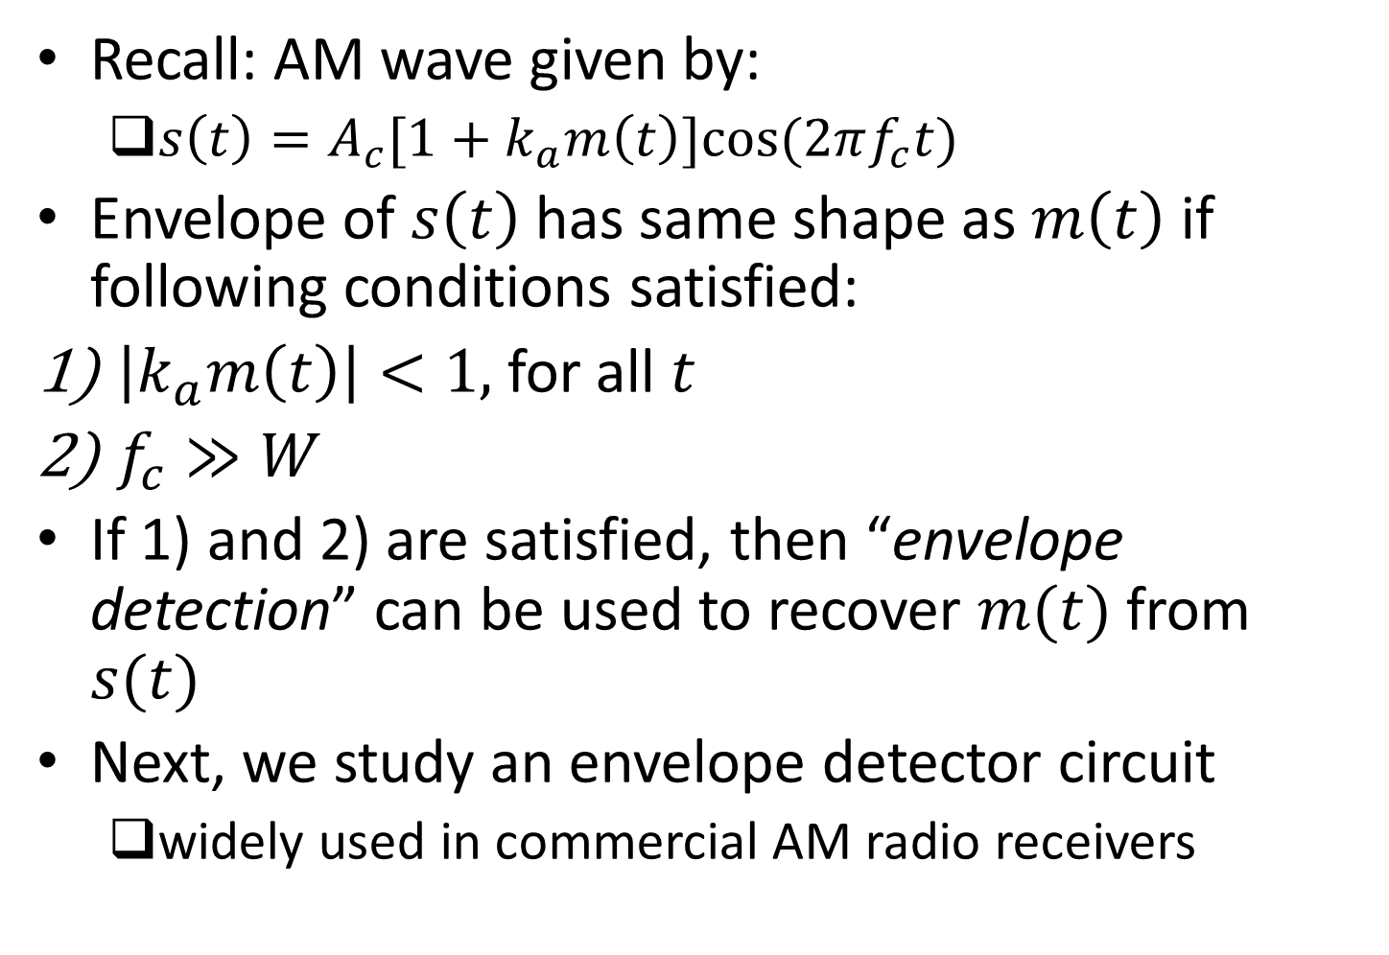
Envelope Detector
Recall: AM wave given by:
$s\left(t\right)=A_{c}[1+k_{a}m\left(t\right)]cos⁡(2πf_{c}t)$
Envelope of $s\left(t\right)$ has same shape as $m\left(t\right)$ if following conditions satisfied:
$\left|k_{a}m\left(t\right)\right|<1,$ for all $t$
$f_{c}≫W$
If 1) and 2) are satisfied, then “envelope detection” can be used to recover $m(t)$ from $s(t)$
Next, we study an envelope detector circuit
widely used in commercial AM radio receivers

Slide 6
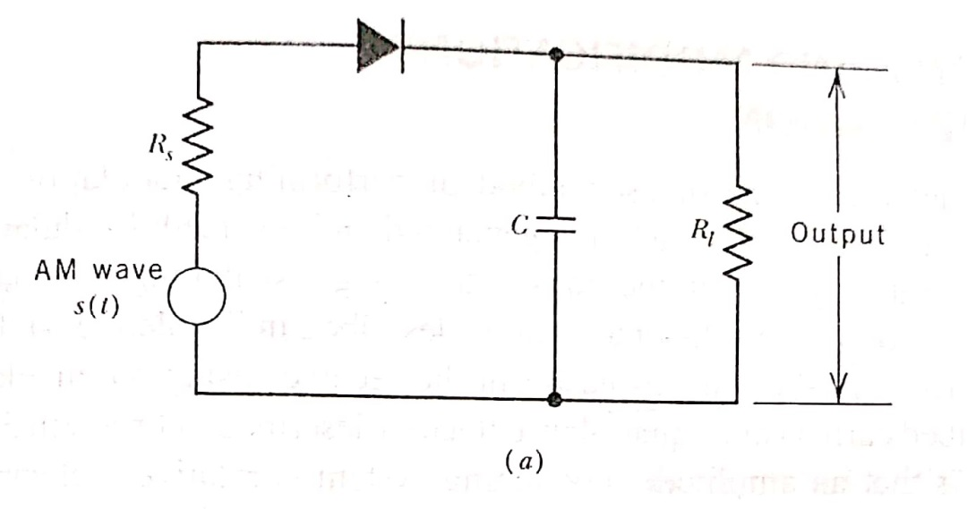
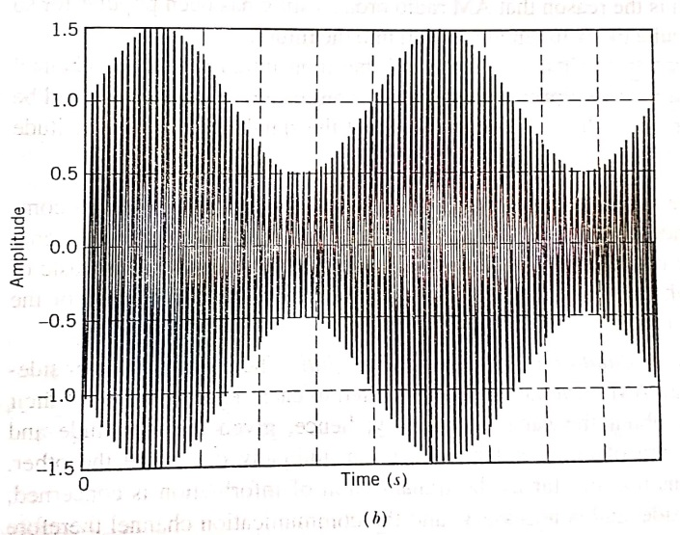
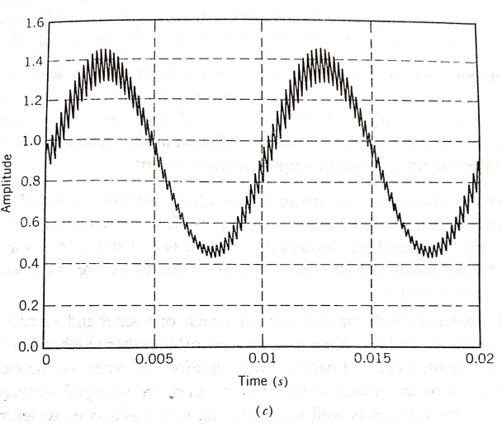
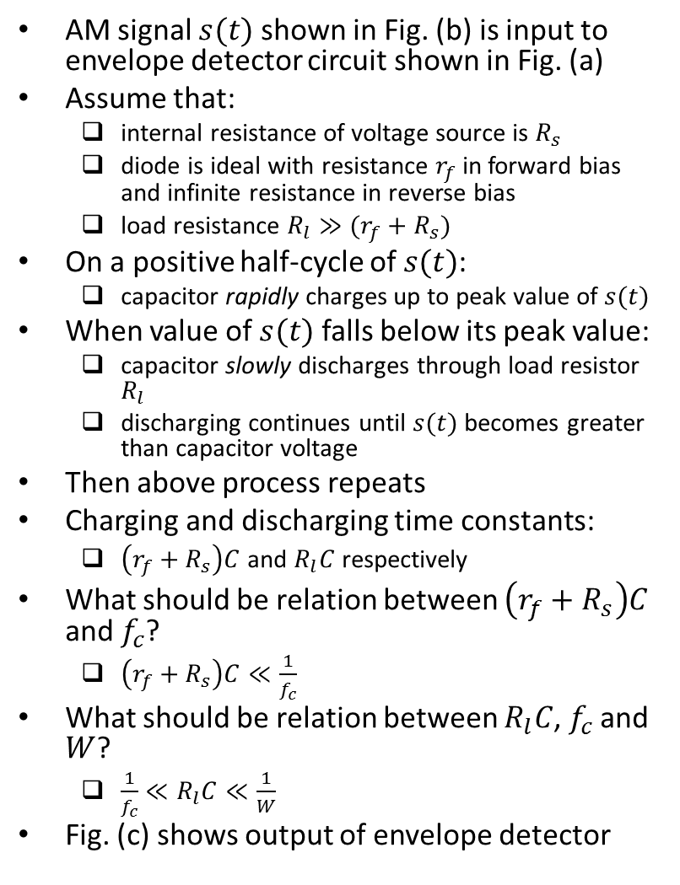
Envelope Detector (contd.)
AM signal $s(t)$ shown in Fig. (b) is input to envelope detector circuit shown in Fig. (a)
Assume that:
internal resistance of voltage source is $R_{s}$
diode is ideal with resistance $r_{f}$ in forward bias and infinite resistance in reverse bias
load resistance $R_{l}≫(r_{f}+R_{s})$
On a positive half-cycle of $s(t)$:
capacitor rapidly charges up to peak value of $s(t)$
When value of $s(t)$ falls below its peak value:
capacitor slowly discharges through load resistor $R_{l}$
discharging continues until $s(t)$ becomes greater than capacitor voltage
Then above process repeats
Charging and discharging time constants:
$\left(r_{f}+R_{s}\right)C$ and $R_{l}C$ respectively
What should be relation between $\left(r_{f}+R_{s}\right)C$ and $f_{c}$?
$\left(r_{f}+R_{s}\right)C≪\frac{1}{f_{c}}$
What should be relation between $R_{l}C$, $f_{c}$ and $W$?
$\frac{1}{f_{c}}≪R_{l}C≪\frac{1}{W}$
Fig. (c) shows output of envelope detector
Ref: “Communication Systems” by S. Haykin and M. Moher, 5th ed

Slide 7
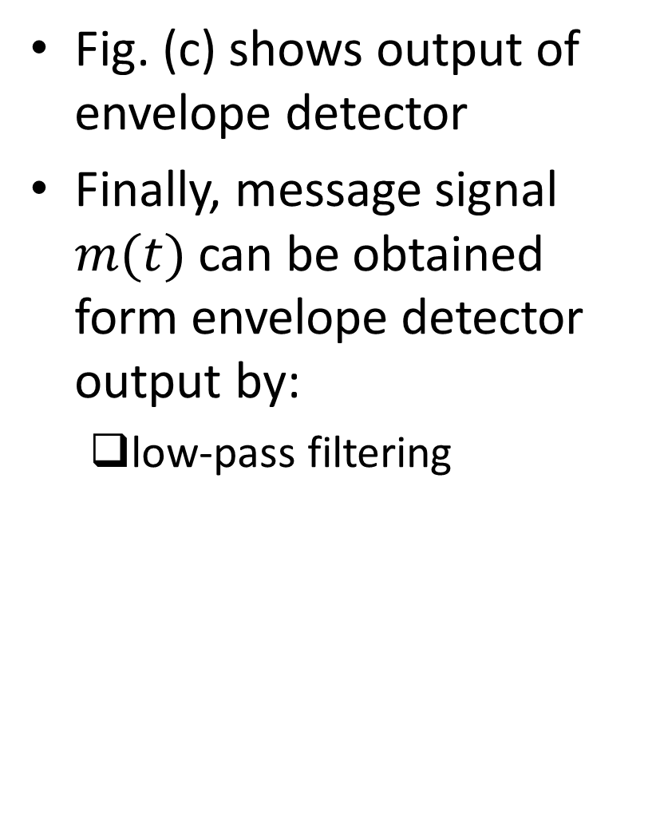
Envelope Detector (contd.)
Fig. (c) shows output of envelope detector
Finally, message signal $m(t)$ can be obtained form envelope detector output by:
low-pass filtering
Ref: “Communication Systems” by S. Haykin and M. Moher, 5th ed

Slide 8
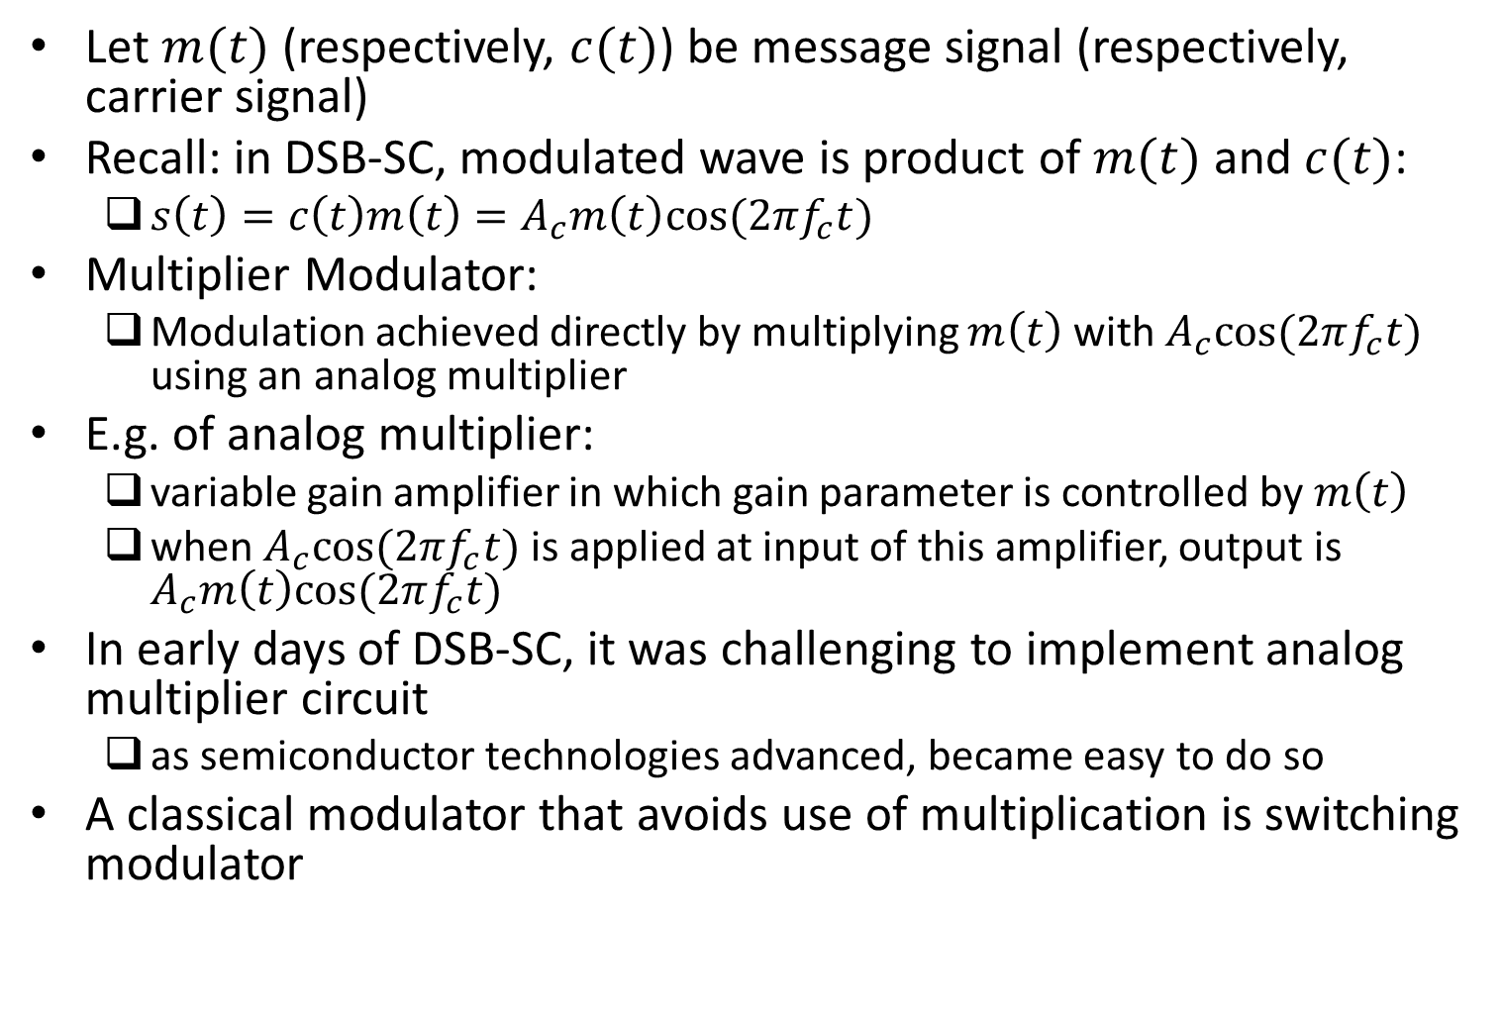
Generation of DSB-SC Signal
Let $m(t)$ (respectively, $c(t)$) be message signal (respectively, carrier signal)
Recall: in DSB-SC, modulated wave is product of $m(t)$ and $c(t)$:
$s\left(t\right)=c\left(t\right)m\left(t\right)=A_{c}m\left(t\right)cos⁡(2πf_{c}t)$
Multiplier Modulator:
Modulation achieved directly by multiplying $m\left(t\right)$ with $A_{c}cos⁡(2πf_{c}t)$ using an analog multiplier
E.g. of analog multiplier:
variable gain amplifier in which gain parameter is controlled by $m\left(t\right)$
when $A_{c}cos⁡(2πf_{c}t)$ is applied at input of this amplifier, output is $A_{c}m\left(t\right)cos⁡(2πf_{c}t)$
In early days of DSB-SC, it was challenging to implement analog multiplier circuit
as semiconductor technologies advanced, became easy to do so
A classical modulator that avoids use of multiplication is switching modulator

Slide 9
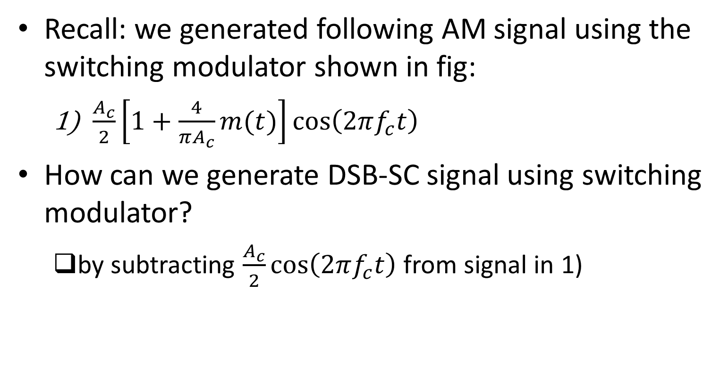
Switching Modulator
Recall: we generated following AM signal using the switching modulator shown in fig:
$\frac{A_{c}}{2}\left[1+\frac{4}{πA_{c}}m(t)\right]\cos\left(2πf_{c}t\right)$
How can we generate DSB-SC signal using switching modulator?
by subtracting $\frac{A_{c}}{2}\cos\left(2πf_{c}t\right)$ from signal in 1)
Ref: “Communication Systems” by S. Haykin and M. Moher, 5th ed

Slide 10
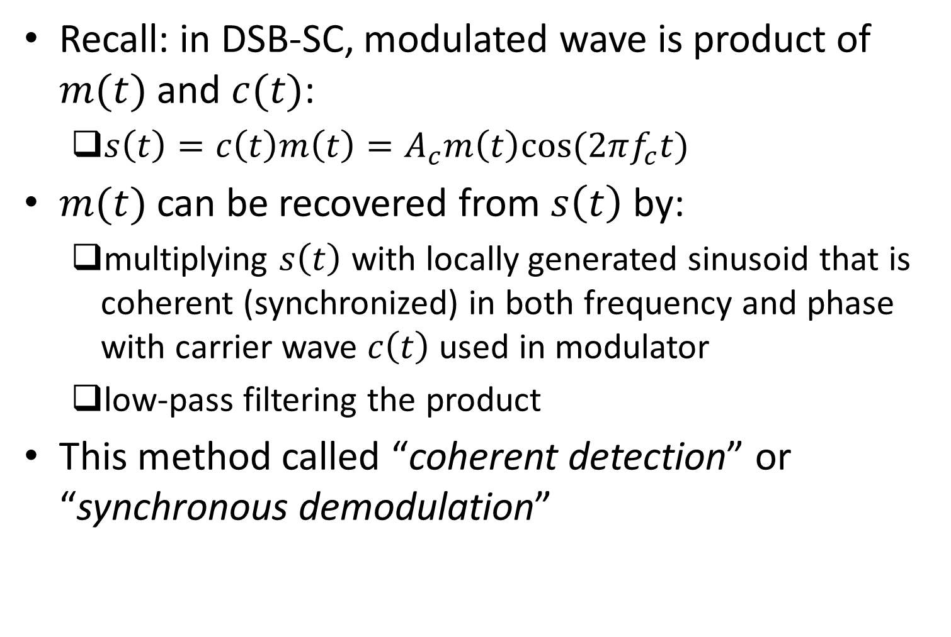
Coherent Detection
Recall: in DSB-SC, modulated wave is product of $m(t)$ and $c(t)$:
$s\left(t\right)=c\left(t\right)m\left(t\right)=A_{c}m\left(t\right)cos⁡(2πf_{c}t)$
$m(t)$ can be recovered from $s\left(t\right)$ by:
multiplying $s\left(t\right)$ with locally generated sinusoid that is coherent (synchronized) in both frequency and phase with carrier wave $c\left(t\right)$ used in modulator
low-pass filtering the product
This method called “coherent detection” or “synchronous demodulation”

Slide 11
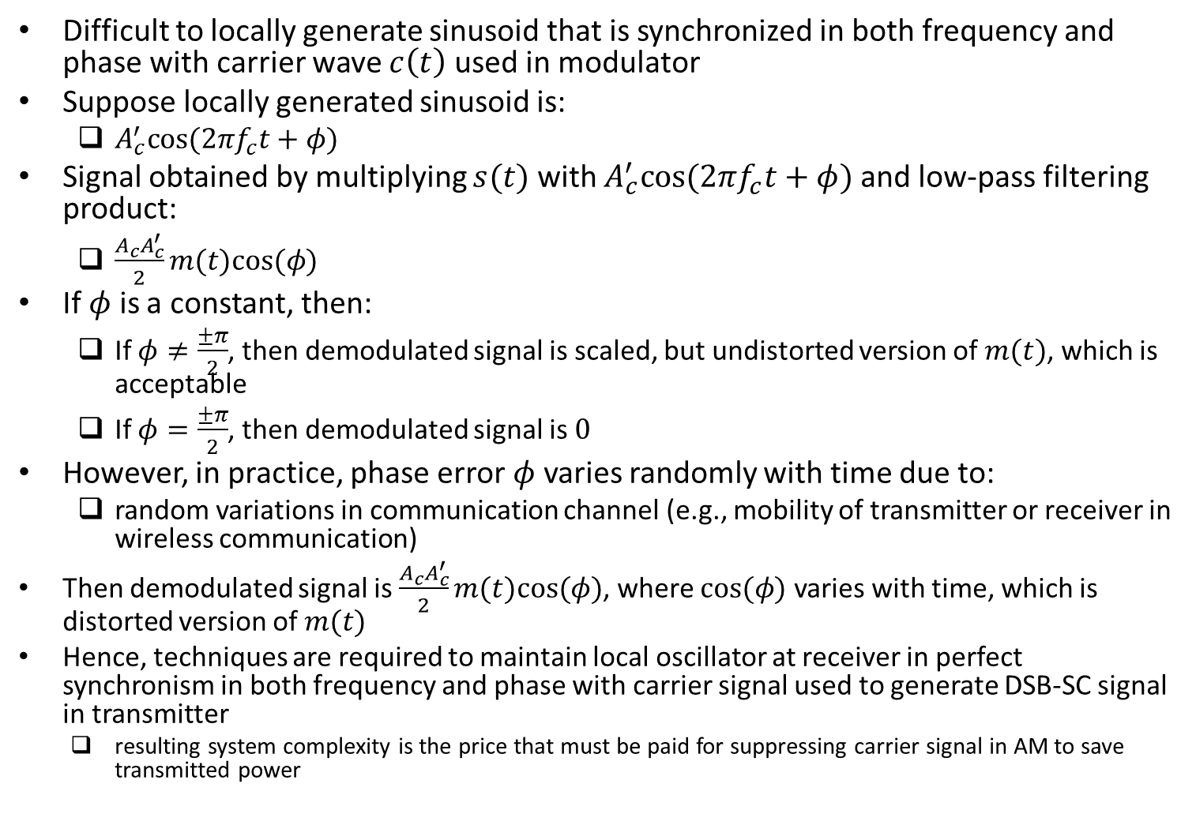
Demodulation Using A Local Oscillator with Phase Error
Difficult to locally generate sinusoid that is synchronized in both frequency and phase with carrier wave $c\left(t\right)$ used in modulator
Suppose locally generated sinusoid is:
$A_{c}^{′}cos⁡(2πf_{c}t+φ)$
Signal obtained by multiplying $s(t)$ with $A_{c}^{′}cos⁡(2πf_{c}t+φ)$ and low-pass filtering product:
$\frac{{A_{c}A}_{c}^{′}}{2}m(t)cos⁡(φ)$
If $φ$ is a constant, then:
If $φ≠\frac{±π}{2}$, then demodulated signal is scaled, but undistorted version of $m(t)$, which is acceptable
If $φ=\frac{±π}{2}$, then demodulated signal is $0$
However, in practice, phase error $φ$ varies randomly with time due to:
random variations in communication channel (e.g., mobility of transmitter or receiver in wireless communication)
Then demodulated signal is $\frac{{A_{c}A}_{c}^{′}}{2}m(t)cos⁡(φ)$, where $cos⁡(φ)$ varies with time, which is distorted version of $m(t)$
Hence, techniques are required to maintain local oscillator at receiver in perfect synchronism in both frequency and phase with carrier signal used to generate DSB-SC signal in transmitter
resulting system complexity is the price that must be paid for suppressing carrier signal in AM to save transmitted power

Slide 12
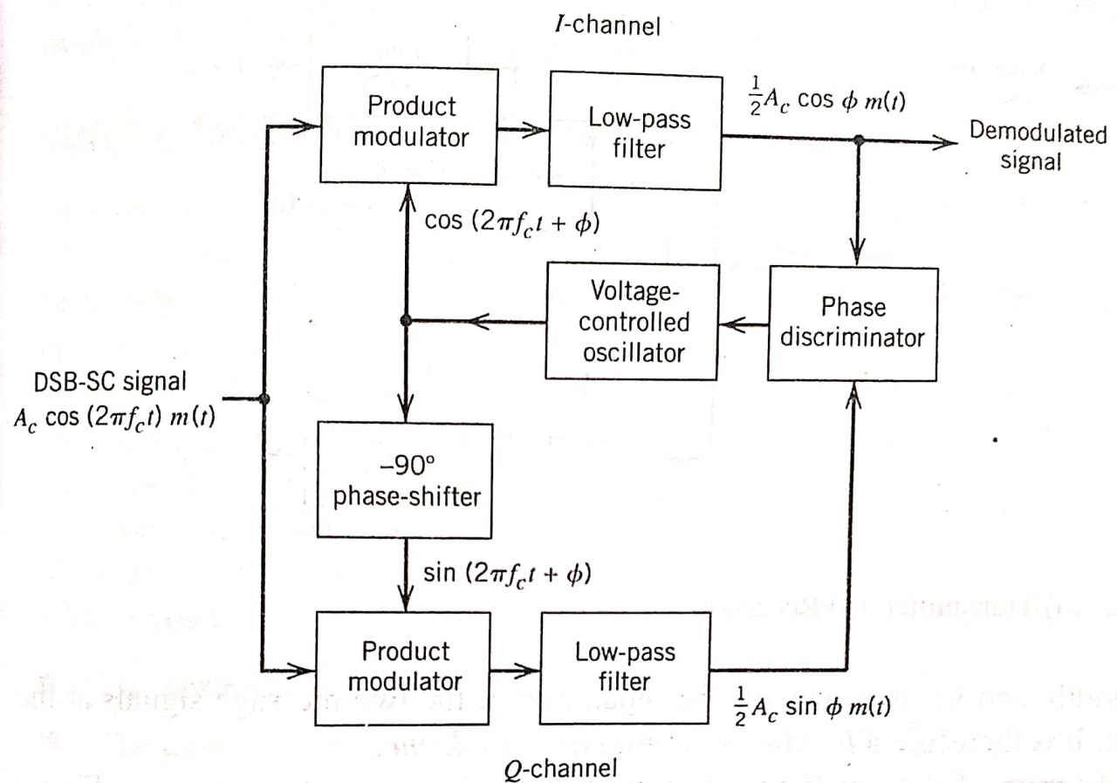
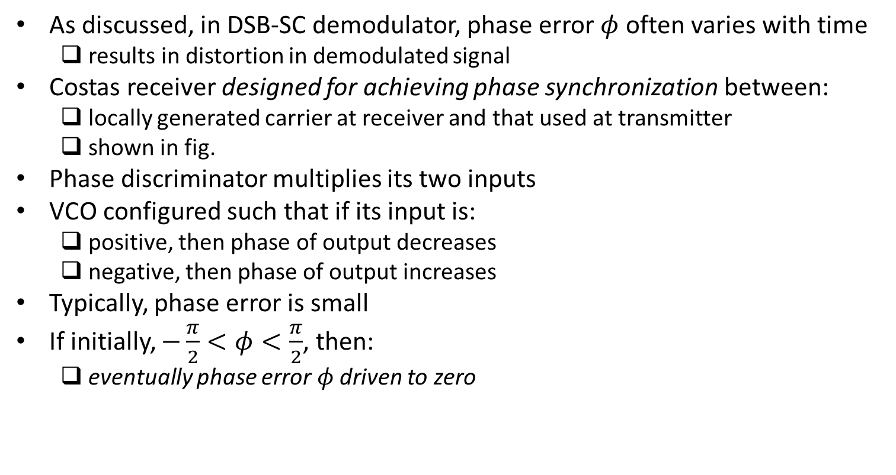
Costas Receiver
As discussed, in DSB-SC demodulator, phase error $φ$ often varies with time
results in distortion in demodulated signal
Costas receiver designed for achieving phase synchronization between:
locally generated carrier at receiver and that used at transmitter
shown in fig.
Phase discriminator multiplies its two inputs
VCO configured such that if its input is:
positive, then phase of output decreases
negative, then phase of output increases
Typically, phase error is small
If initially, $−\frac{π}{2}<φ<\frac{π}{2}$, then:
eventually phase error $φ$ driven to zero
Ref: “Communication Systems” by S. Haykin and M. Moher, 5th ed

